Slide 1

School of Computing Science and Engineering
Course Code : RiUC604C Course Name: Deep Learning
Gradient Descent and Activation Functions
Name of the Faculty: Dr. Abdul Aleem Program Name: B.Tech

Slide 2
School of Computing Science and Engineering
Course Code : R1UC604C Course Name: Deep Learning
Gradient Descent
Gradient descent was initially discovered by "Augustin-Louis Cauchy" in mid of 18th century. Gradient Descent is defined as one of the most commonly used iterative optimization algorithms of machine learning to train the machine learning and deep learning models. It helps in finding the local minimum of a function.
It is used most commonly used optimization algorithms to train machine learning models by means of minimizing errors between actual and expected results. Further, gradient descent is also used to train Neural Networks.
Name of the Faculty: Dr. Abdul Aleem Program Name: B.Tech

Slide 3
School of Computing Science and Engineering
Course Code : R1UC604C Course Name: Deep Learning
The best way to define the local minimum or local maximum of a function using gradient descent is as follows:
If we move towards a negative gradient or away from the gradient of the function at the current point, it will give the local minimum of that function.
Whenever we move towards a positive gradient or towards the gradient of the function at the current point, we will get the local maximum of that function.
Name of the Faculty: Dr. Abdul Aleem Program Name: B.Tech

Slide 4
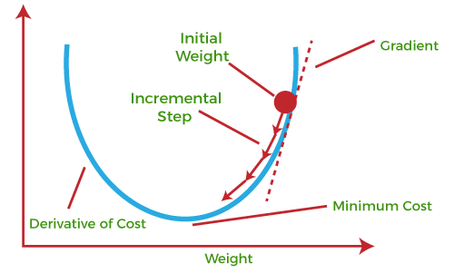
School of Computing Science and Engineering
Course Code : R1UC604C Course Name: Deep Learning
Name of the Faculty: Dr. Abdul Aleem Program Name: B.Tech

Slide 5
School of Computing Science and Engineering
Course Code : R1UC604C Course Name: Deep Learning
This entire procedure is known as Gradient Ascent, which is also known as steepest descent. The main objective of using a gradient descent algorithm is to minimize the cost function using iteration. To achieve this goal, it performs two steps iteratively:
Calculates the first-order derivative of the function to compute the gradient or slope of that function.
Move away from the direction of the gradient, which means slope increased from the current point by alpha times, where Alpha is defined as Learning Rate. It is a tuning parameter in the optimization process which helps to decide the length of the steps.
Name of the Faculty: Dr. Abdul Aleem Program Name: B.Tech

Slide 6
School of Computing Science and Engineering
Course Code : R1UC604C Course Name: Deep Learning
Cost Function
The cost function is defined as the measurement of difference or error between actual values and expected values at the current position and present in the form of a single real number.
It helps to increase and improve machine learning efficiency by providing feedback to this model so that it can minimize error and find the local or global minimum.
Further, it continuously iterates along the direction of the negative gradient until the cost function approaches zero. At this steepest descent point, the model will stop learning further.
Name of the Faculty: Dr. Abdul Aleem Program Name: B.Tech

Slide 7
School of Computing Science and Engineering
Course Code : R1UC604C Course Name: Deep Learning
The cost function is calculated after making a hypothesis with initial parameters and modifying these parameters using gradient descent algorithms over known data to reduce the cost function.
Hypothesis:
Parameters:
Cost function:
Goal:
Name of the Faculty: Dr. Abdul Aleem Program Name: B.Tech

Slide 8
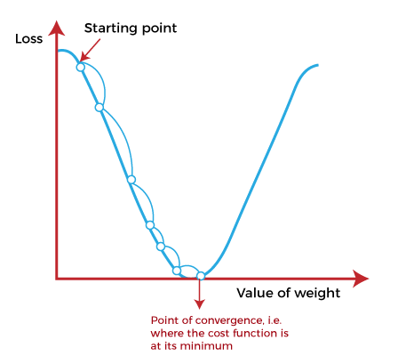
School of Computing Science and Engineering
Course Code : R1UC604C Course Name: Deep Learning
How does Gradient Descent work?
Before starting the working principle of gradient descent, we should know some basic concepts to find out the slope of a line from linear regression.
The equation for simple linear regression is given as:
Y=mx +c, Where 'm' represents the slope of the line, and 'c' represents the intercepts on the y-axis.
Name of the Faculty: Dr. Abdul Aleem Program Name: B.Tech

Slide 9
School of Computing Science and Engineering
Course Code : R1UC604C Course Name: Deep Learning
The main objective of gradient descent is to minimize the cost function or the error between expected and actual. To minimize the cost function, two data points are required:
Direction & Learning Rate
These two factors are used to determine the partial derivative calculation of future iteration and allow it to the point of convergence or local minimum or global minimum. Let's discuss learning rate factors in brief;
Learning Rate:
It is defined as the step size taken to reach the minimum or lowest point. This is typically a small value that is evaluated and updated based on the behavior of the cost function. If the learning rate is high, it results in larger steps but also leads to risks of overshooting the minimum. At the same time, a low learning rate shows the small step sizes, which compromises overall efficiency but gives the advantage of more precision.
Name of the Faculty: Dr. Abdul Aleem Program Name: B.Tech

Slide 10
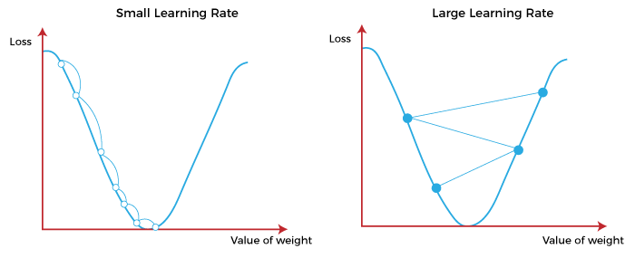
School of Computing Science and Engineering
Course Code : R1UC604C Course Name: Deep Learning
Name of the Faculty: Dr. Abdul Aleem Program Name: B.Tech

Slide 11
School of Computing Science and Engineering
Course Code : R1UC604C Course Name: Deep Learning
Types of Gradient Descent
Based on the error in various training models, the Gradient Descent learning algorithm can be divided into Batch gradient descent, stochastic gradient descent, and mini-batch gradient descent. Let's understand these different types of gradient descent:
1. Batch Gradient Descent:
Batch gradient descent (BGD) is used to find the error for each point in the training set and update the model after evaluating all training examples. This procedure is known as the training epoch. In simple words, it is a greedy approach where we have to sum over all examples for each update.
Advantages of Batch gradient descent:
It produces less noise in comparison to other gradient descent.
It produces stable gradient descent convergence.
It is Computationally efficient as all resources are used for all training samples.
Name of the Faculty: Dr. Abdul Aleem Program Name: B.Tech

Slide 12
School of Computing Science and Engineering
Course Code : R1UC604C Course Name: Deep Learning
2. Stochastic gradient descent
Stochastic gradient descent (SGD) is a type of gradient descent that runs one training example per iteration. Or in other words, it processes a training epoch for each example within a dataset and updates each training example's parameters one at a time.
Advantages of Stochastic gradient descent:
In Stochastic gradient descent (SGD), learning happens on every example, and it consists of a few advantages over other gradient descent.
It is easier to allocate in desired memory.
It is relatively fast to compute than batch gradient descent.
It is more efficient for large datasets.
Name of the Faculty: Dr. Abdul Aleem Program Name: B.Tech

Slide 13
School of Computing Science and Engineering
Course Code : R1UC604C Course Name: Deep Learning
3. MiniBatch Gradient Descent:
Mini Batch gradient descent is the combination of both batch gradient descent and stochastic gradient descent. It divides the training datasets into small batch sizes then performs the updates on those batches separately. Splitting training datasets into smaller batches make a balance to maintain the computational efficiency of batch gradient descent and speed of stochastic gradient descent. Hence, we can achieve a special type of gradient descent with higher computational efficiency and less noisy gradient descent.
Advantages of Mini Batch gradient descent:
It is easier to fit in allocated memory.
It is computationally efficient.
It produces stable gradient descent convergence.
Name of the Faculty: Dr. Abdul Aleem Program Name: B.Tech

Slide 14
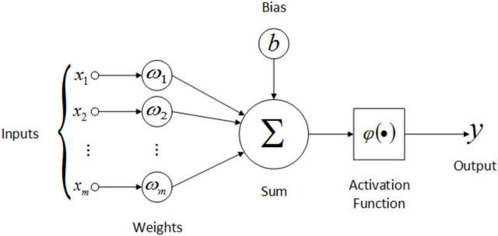

School of Computing Science and Engineering
Course Code : R1UC604C Course Name: Deep Learning
Activation Function
These are basic building blocks of artificial neural network (ANN) architecture.
These are mathematical equations that define how the weighted sum of the input of a neural node is transformed into an output,
The activation function is attached to each neuron in a neural network and determine whether the neuron should be activated or not.
It is also check information received by neurons are relative or not.
To put in simple terms, an artificial neuron calculates the ‘weighted sum’ of its inputs and adds a bias, as shown in the figure below by the net input.
Name of the Faculty: Dr. Abdul Aleem Program Name: B.Tech

Slide 15
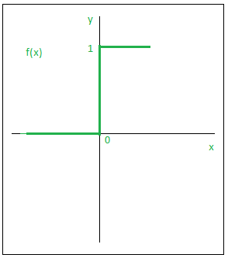
School of Computing Science and Engineering
Course Code : R1UC604C Course Name: Deep Learning
Types of Activation Functions
Step Function:
It is also known as Threshold function.
Step Function is one of the simplest kind of activation functions.
In this, we consider a threshold value and if the value of net input say x is greater than the threshold then the neuron is activated.
Mathematically,
Name of the Faculty: Dr. Abdul Aleem Program Name: B.Tech

Slide 16
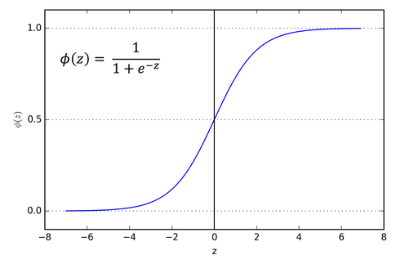
School of Computing Science and Engineering
Course Code : R1UC604C Course Name: Deep Learning
Types of Activation Functions Contd …
2. Sigmoid or Logistic Activation Function
It is a function which is plotted as ‘S’ shaped graph.
The main reason why we use sigmoid function is because it exists between (0 to 1).
Therefore, it is especially used for models where we have to predict the probability as an output.
Name of the Faculty: Dr. Abdul Aleem Program Name: B.Tech

Slide 17
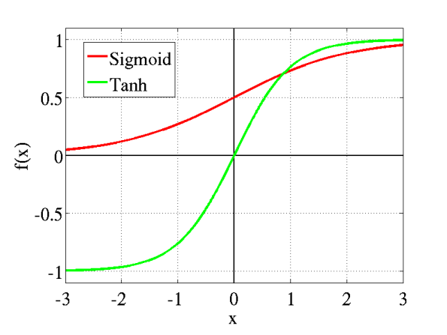
School of Computing Science and Engineering
Course Code : R1UC604C Course Name: Deep Learning
Types of Activation Functions Contd …
3. Tanh or hyperbolic tangent Activation Function
tanh is also like logistic sigmoid but better.
The range of the tanh function is from (-1 to 1). tanh is also sigmoidal (s - shaped).
Hyperbolic Tangent Function: tanh(x) = (ex – e-x) / (ex + e-x)
Name of the Faculty: Dr. Abdul Aleem Program Name: B.Tech

Slide 18
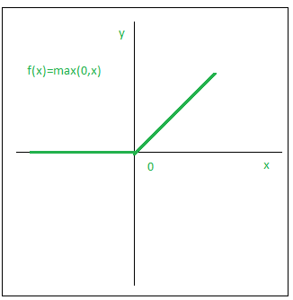
School of Computing Science and Engineering
Course Code : R1UC604C Course Name: Deep Learning
Types of Activation Functions Contd …
4. ReLU (Rectified Linear Unit) Activation Function
It is the most widely used activation function. It is defined as:
The main advantage of using the ReLU function over other activation functions is that it does not activate all the neurons at the same time.
Name of the Faculty: Dr. Abdul Aleem Program Name: B.Tech

Slide 19


